Slide 1
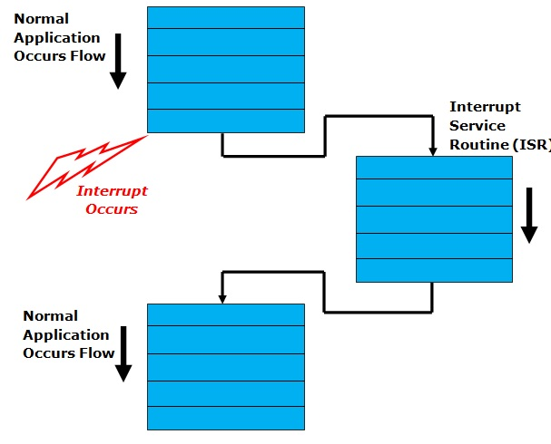
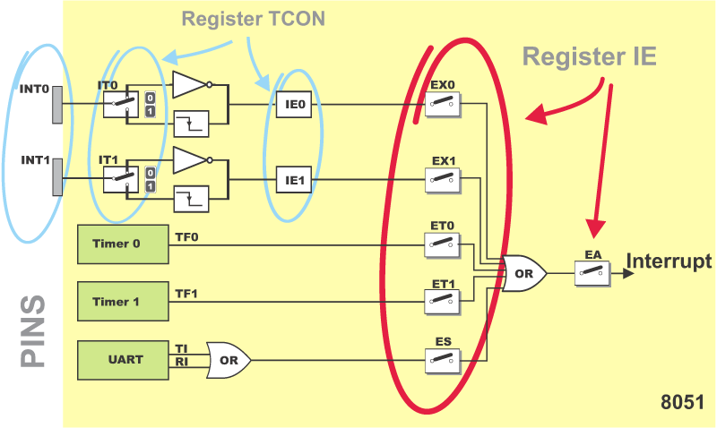
Interrupts in Microcontroller Timer Interrupt

Slide 2
What is the Interrupt?
Interrupt is a signal from device attached to a computer or from a program within a controller that causes main program to stop and figure out what to do next.
ISR (Interrupt Service Routine) is executed when an interrupt occurs. A section of a program that takes control when an interrupt is received and perform the operations required to service the interrupt.

Slide 3
How Interrupt Works?
Whenever any device needs service of microcontroller, the device notifies the microcontroller by sending interrupt signal.
The microcontroller stops or interrupt main program flow and saves the address of the next instruction (PC) on the stack pointer (SP)
MCU/MPU jumps to a fixed location in memory, called interrupt vector table that hold the address of the ISR (Interrupt Service Routine). Each interrupt has its own ISR. The microcontroller gets the address of the ISR from the interrupt vector table and jump to it
It starts to execute the Interrupt Service Routine until it reaches the last instruction of the subroutine which is RETI (Return from Interrupt). RETI not used in C Coding. (Fig: Interrupt and ISR Relation)
MCU/MPU gets the program counter (PC) address from the stack pointer by popping the top two bytes of the stack into the PC
Then it starts to execute from that address and continue executing main program.

Slide 4
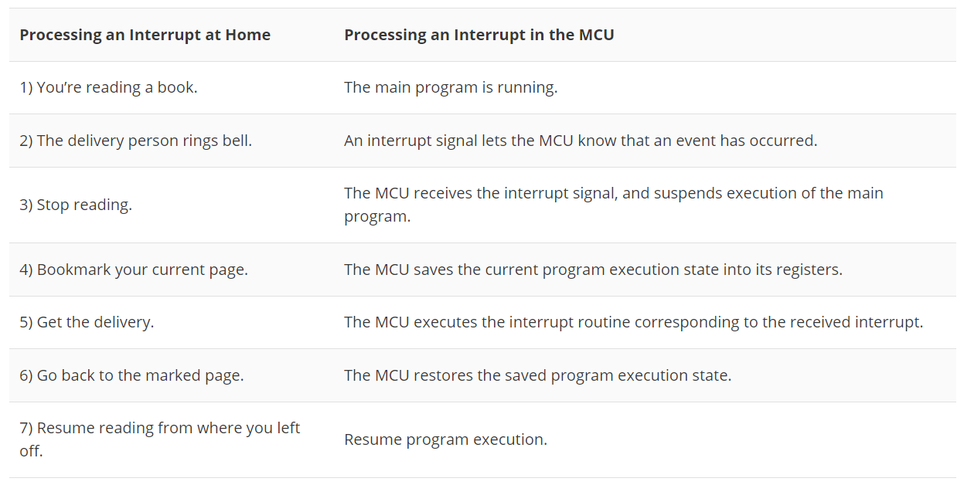
Reading a Book vs Interrupts in MCU

Slide 5
Advantages - Disadvantages
It increases the efficiency of CPU.
It decreases the waiting time of CPU.
Stops the wastage of instruction cycle.
Enables multitasking by allowing the CPU to quickly switch between different processes.
Simplifies input/output (I/O) operations by allowing devices to communicate directly with the CPU.
The keyword to build RTOS
CPU has to handle interrupts, resume its previous execution of programs
Overhead required to handle the interrupt request can reduce the efficiency of the system
Nested interrupts can occur when there is high levels of interrupt activity
Priority inversion can occur when a low-priority task holds a resource needed by a higher-priority task

Slide 6
Types of Interrupts
Hardware interrupts:
Maskable: Can be masked or disabled
Non-maskable: Cannot be disabled
External and Internal interrupts
Software interrupts: generally used when the situation requires stop processing and start all over:
Divide by zero or stack overflow
Generally, MPUs do not include software interrupts
Exeptions…

Slide 7
Multiple Interrupts (Priority)
ISR1
ISR2
ISR1
main
main
Preemption: The execution of an interrupt handler can be preempted by an exception having a higher priority
Tail-chaining: When an interrupt is pending on completion of an exception handler. When the first interrupt complete its execution, the controller transfers immediately to the new execution
ISR1
ISR2
main
main

Slide 8
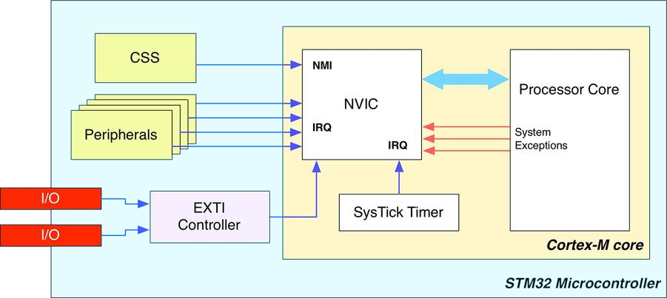
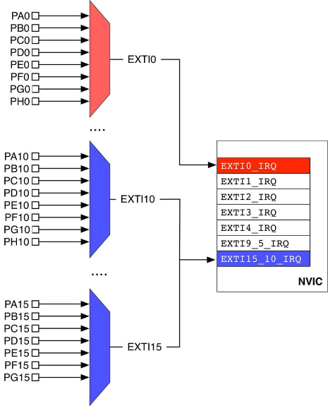
Interrupts in STM32 Cortex M

Slide 9
Interrupt handler in STM Cortex M
Nested Vectored Interrupt Controller (NVIC): provides implementation schemes for handling interrupts that occur when other interrupts are being executed or when the CPU is in the process of restoring its previous state and resuming its suspended process

Slide 10

Components of NVIC
Clock Security System (CSS) interrupt is connected to Non-Maskable Interrupt (NMI) lines
Peripheral interrupts are connected to Interrupt Requests (IRQ) lines
GPIO interrupts are connected to an External Interrupt/Event Controller (EXTI) before connecting to the IRQ lines

Slide 11
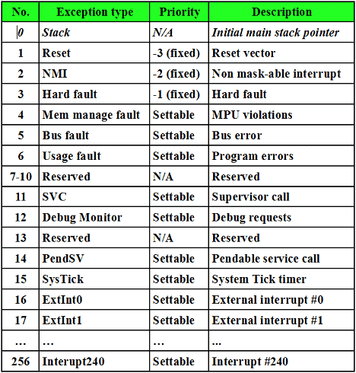
Interrupt Request (IRQs) Table
Reset: It is a special kind of exception. When reset is activated, the CPU goes to a known state with all registers loaded with the predefined values. When the device is coming out of reset, the ARM loads the program counter from memory location at 0x000.0004. Reset has the highest priority
NMI: The non-maskable interrupt (NMI) has the second highest priority after Reset. It cannot be masked by software, for this reason, it is called non-maskable interrupt. Whenever it is activated, the CPU will go to address 0x0000.0008 to get the address of its interrupt service routine.

Slide 12
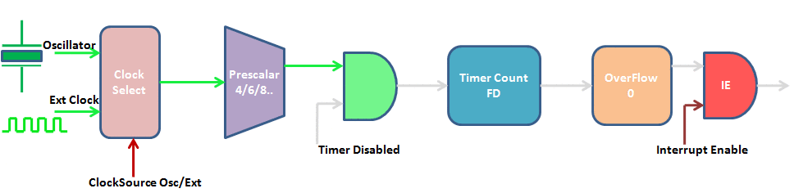
Timer Interrupt

Slide 13
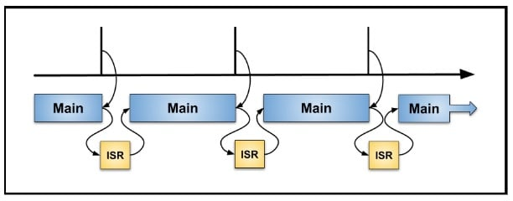
Timer Interrupt
The main program and a timer are asynchronous, which means the timer operates independently of program flow
Main program running on the processor. A timer event occurs and triggers an interrupt.

Slide 14
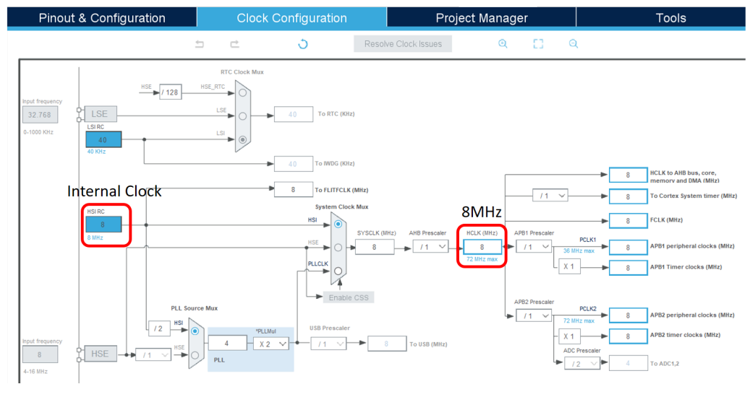
Clock Configuration
HCLK is used for the timer oscillation

Slide 15
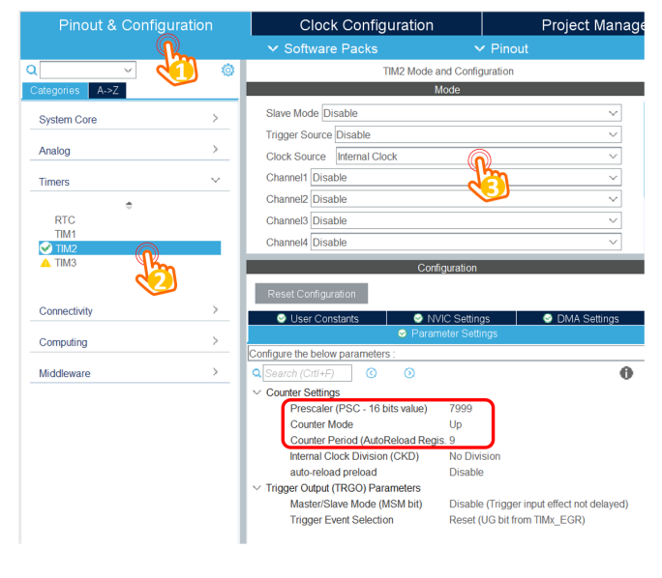
Parameter Settings
The clock source is 8MHz, by setting the prescaller to 7999, the input clock source to the timer is 8MHz/(7999+1) = 1000Hz
The interrupt is raised when the timer counter is counted from 0 to 9, meaning that the frequency is divided by 10, which is 100Hz.
The frequency of the timer interrupt is 100Hz, meaning that the period is 1/100Hz = 10ms

Slide 16
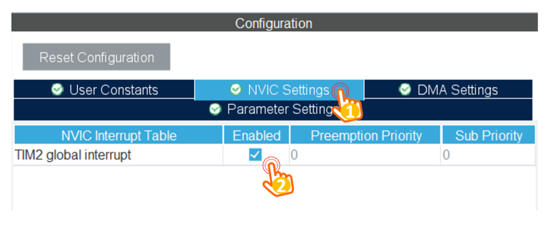
NVIC Settings
Timer is a maskable interrupt

Slide 17
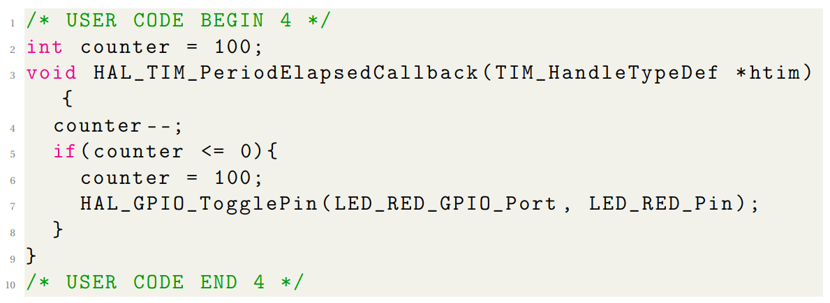
ISR Implementation

